Slide 1
SD7502 Intelligent Systems Development Project 1
­­­Qiang Zhang
2173138
31 August 2021

Slide 2
Contents:
The EMNIST Dataset
Classification Algorithm
Multi-Classification of Digits and Letters with the EMNIST Dataset
Conclusion
References

Slide 3
The EMNIST Dataset
What is it?
The EMNIST dataset is a standard benchmark for learning, classification, and computer vision system. It is a database of handwritten digits and letter images and labels. The image can be converted from the data set to 28 by 28 pixels picture.
Formats
MATLAB format
Binary format
Dataset Summary
Letters: 145,600 characters. 26 balanced classes (From 0 to 9).
Digits: 280,000 characters. 10 balanced classes(From a to z).

Slide 4
Classification Algorithm
k-Nearest Neighbours Algorithm (kNN)
Support Vector Clustering Algorithm (SVC)
GaussianNB Algorithm
LinearSVC Algorithm
SGDClassifier Algorithm
Decision Tree Algorithm

Slide 5
Multi-Classification of Digits and Letters with the EMNIST Dataset
Load Data
Explore Data
Visualize Data
Hyperparameter Tuning
Running Multiple Models to Find the Top 3 Algorithm
Performance Testing the Top 3 Algorithm

Slide 6
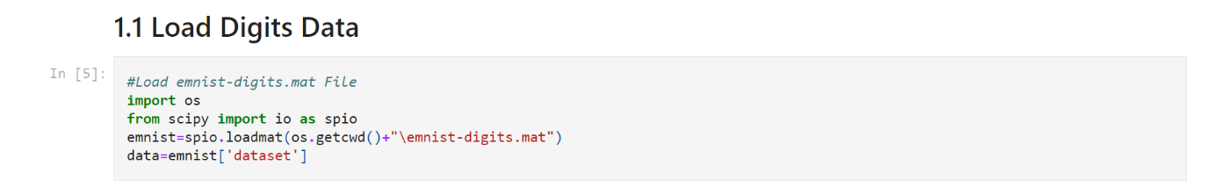
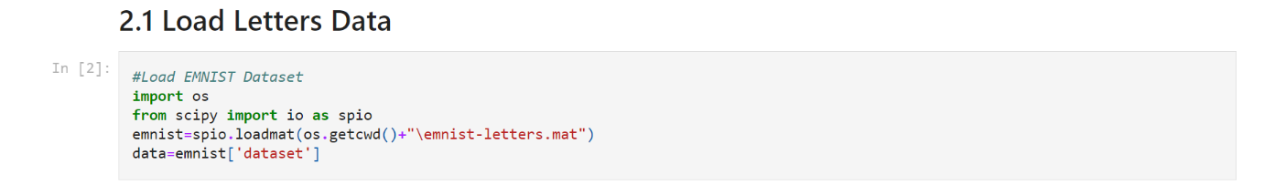
Load Digits and Letters Data
Using SciPy open-source Python library to Load Digits and Letters MATLAB format Data.

Slide 7
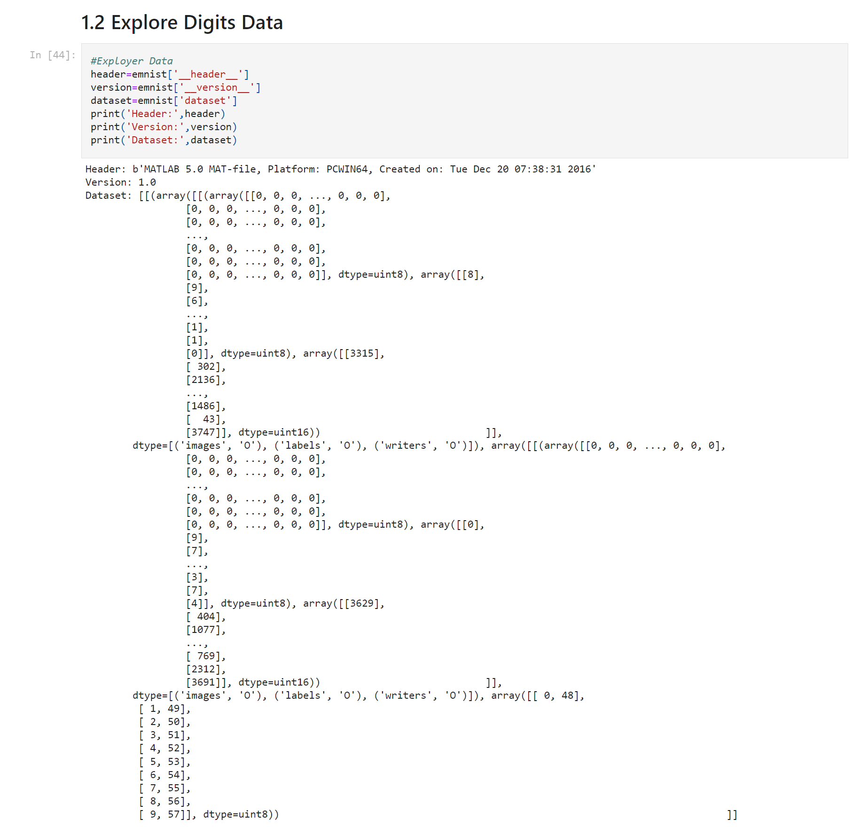
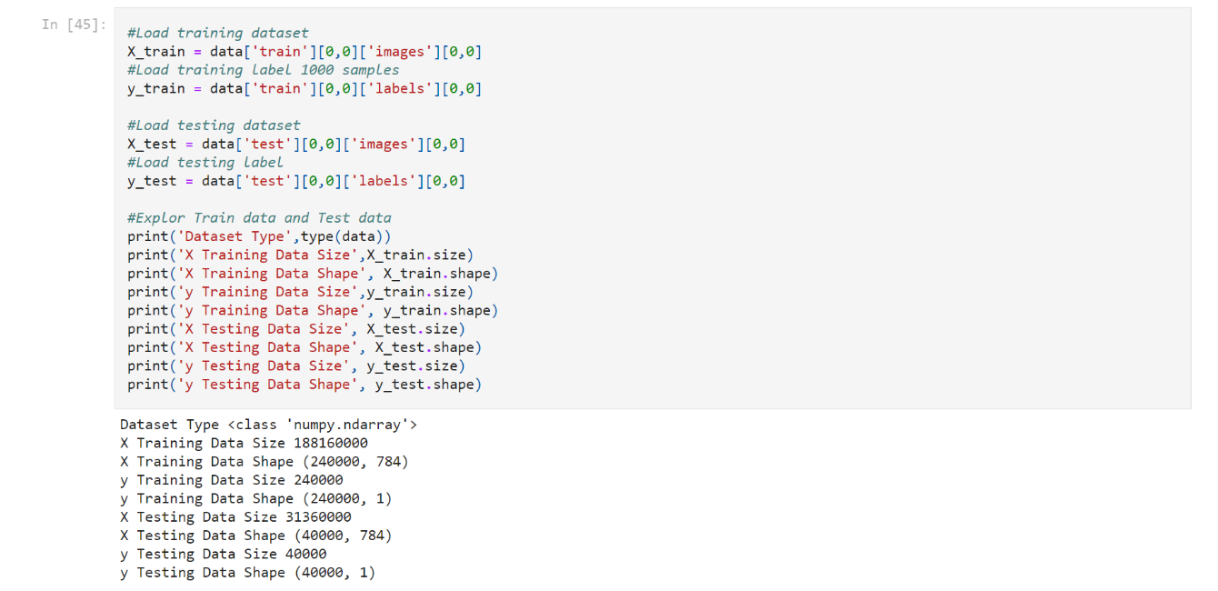
Explore Digits Data
The EMNIST digits dataset splits into training dataset and testing dataset.
Load training dataset and testing dataset as well as explore them.
X is image data and y is label data.

Slide 8
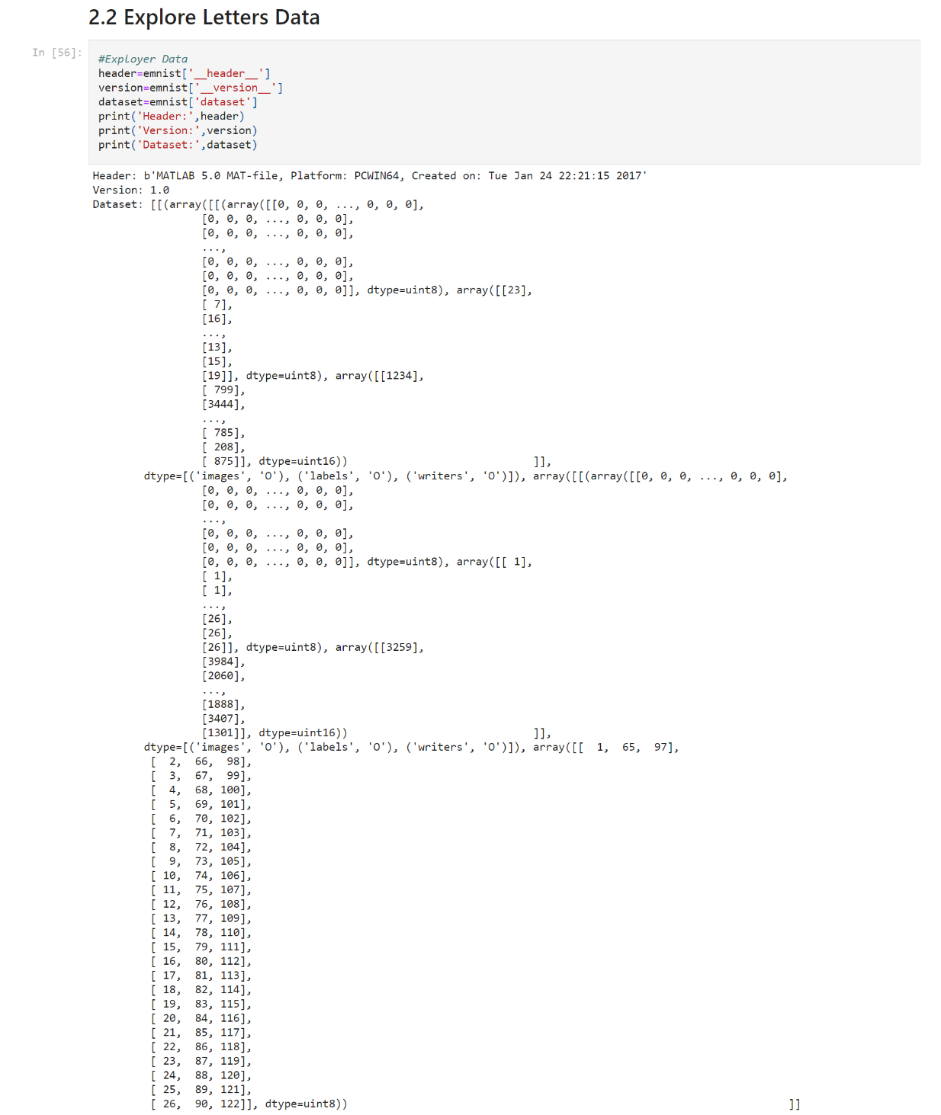
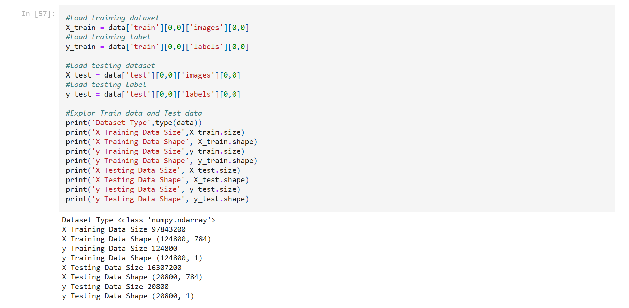
Explore Letters Data
The EMNIST letters dataset splits into training dataset and testing dataset.
Load training dataset and testing dataset as well as explore them.
X is image data and y is label data.

Slide 9
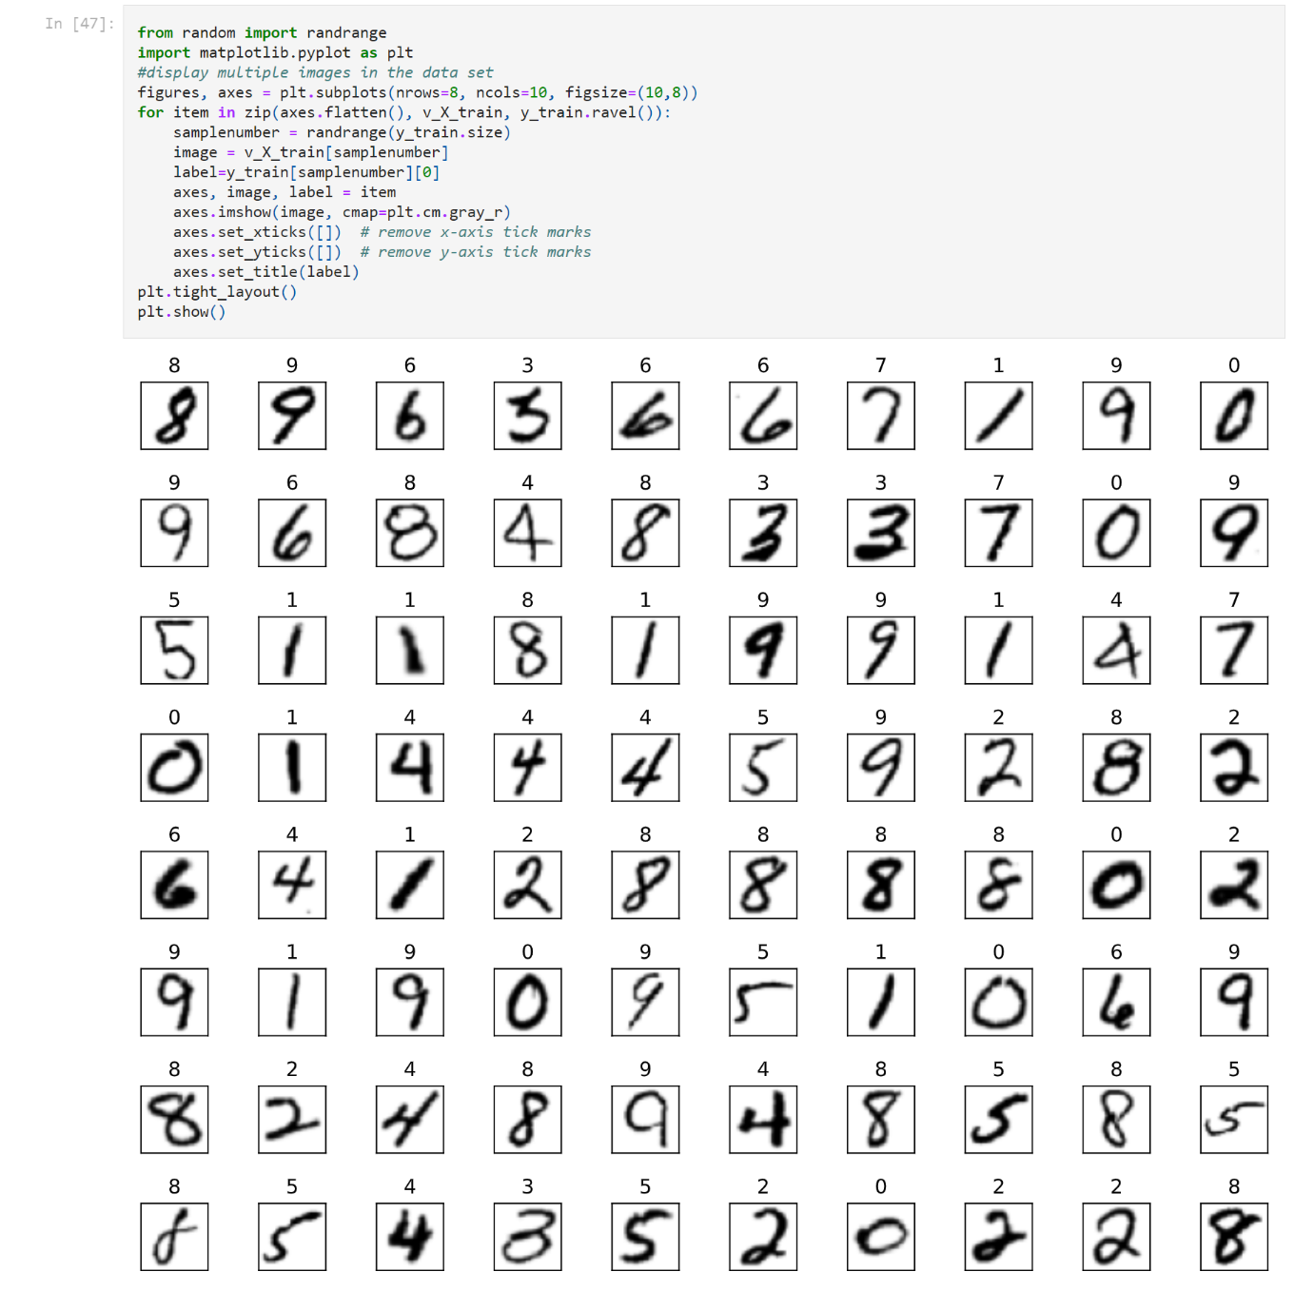
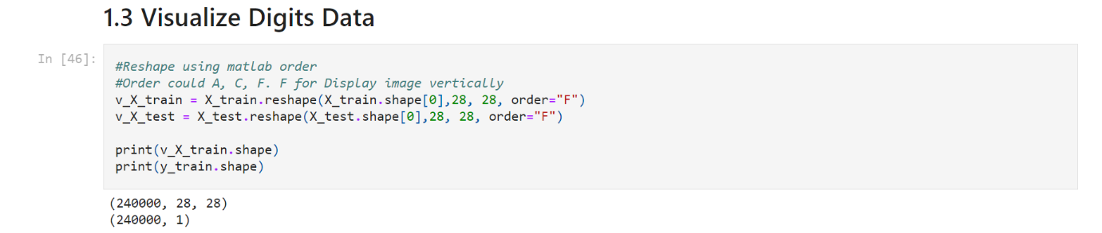
Visualize Digits Data
Using matplotib.pylot open-source Python library to display Digits image
Reshape image data from MATLAB to pyplot format

Slide 10
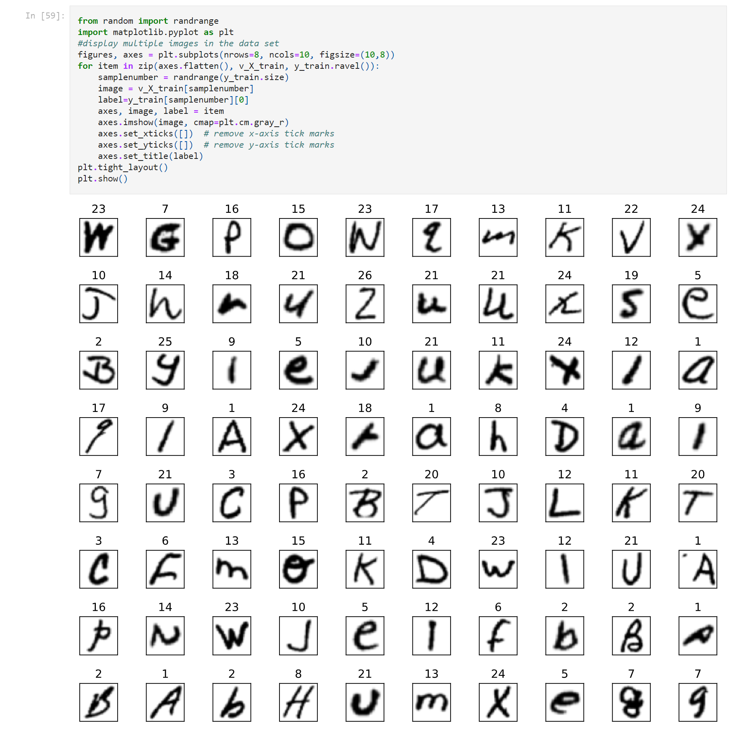
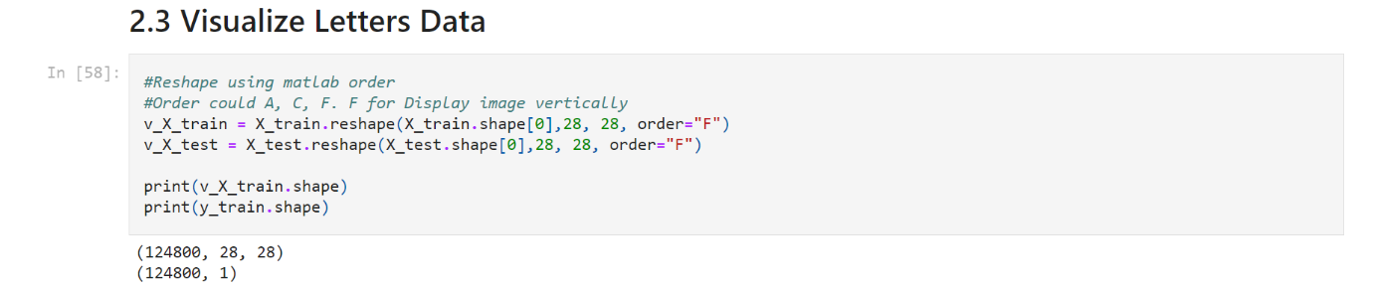
Visualize Letters Data
Using matplotib.pylot open-source Python library to display Letters image
Reshape image data from MATLAB to pyplot format

Slide 11
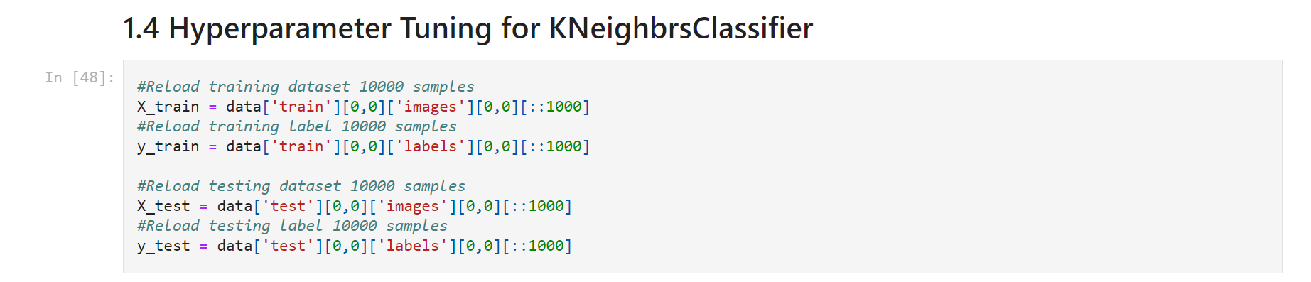
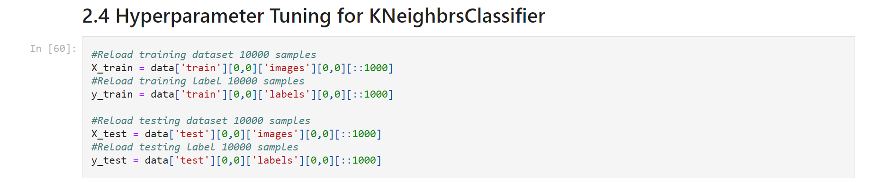
Hyperparameter Tuning
Reload training and testing dataset with 1000 samples each to reduce test time.

Slide 12
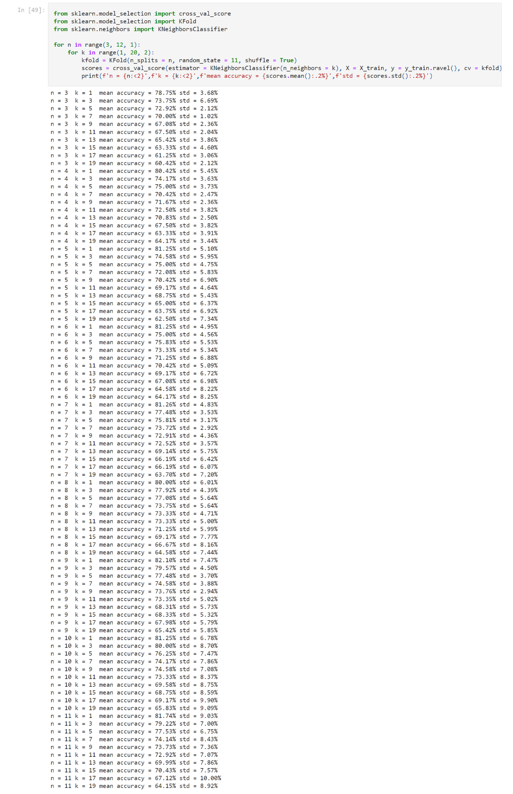
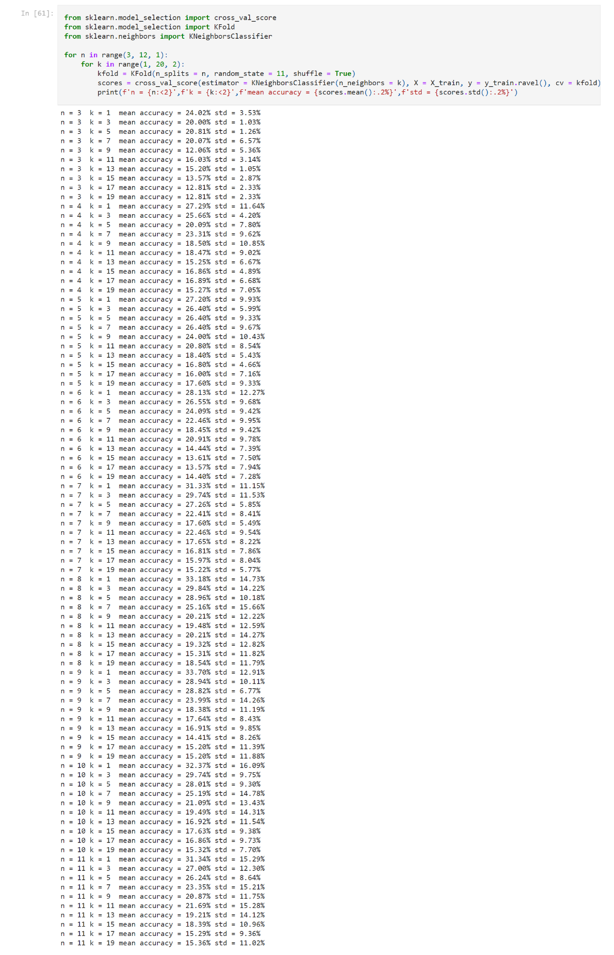
Hyperparameter Tuning
Hyperparameter tuning is used to choose hyperparameter values that produce the best possible predictions.
To determine the best value for n in the K-Fold Cross-Validation, try different values of n then compare each estimator’s performance.
To determine the best value for k in the kNN algorithm, try different values of k then compare each estimator’s performance.
n=3 and k=1 that produce the best possible predictions.

Slide 13
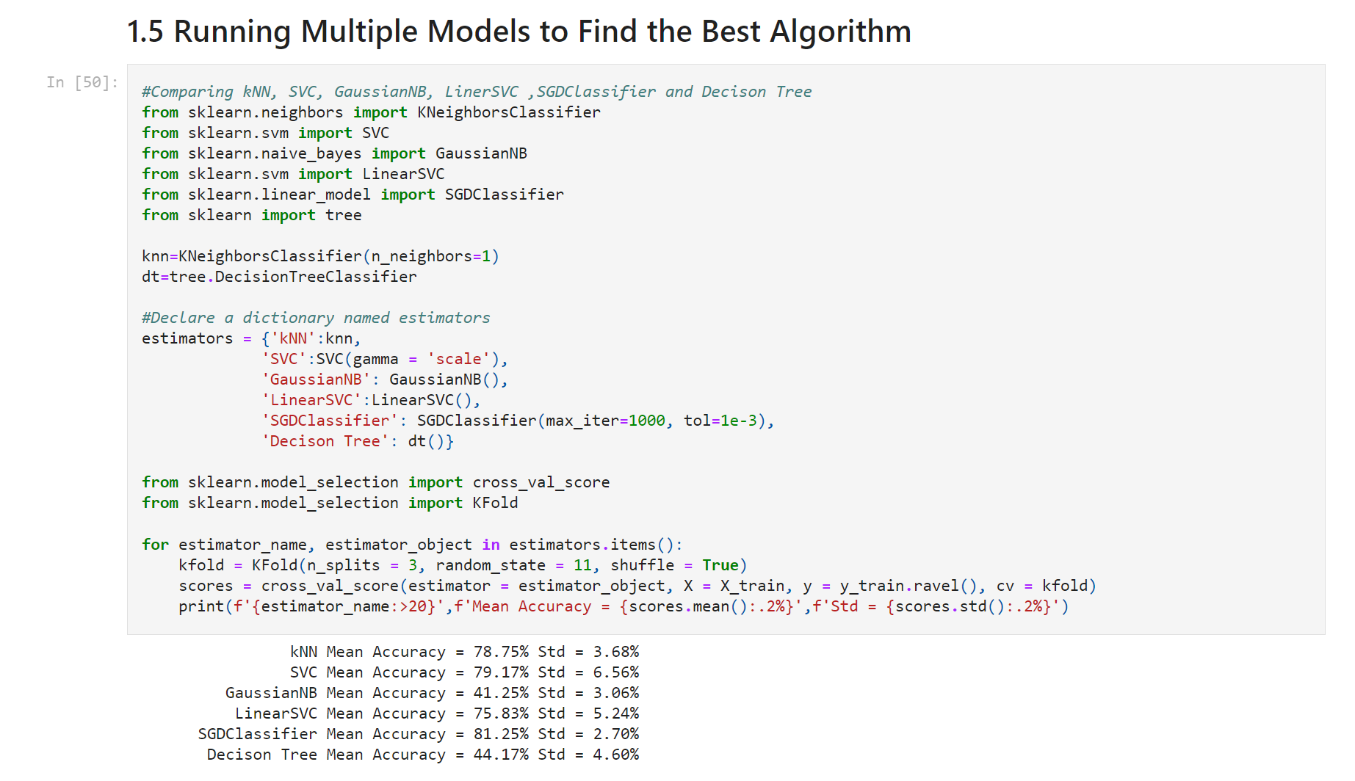
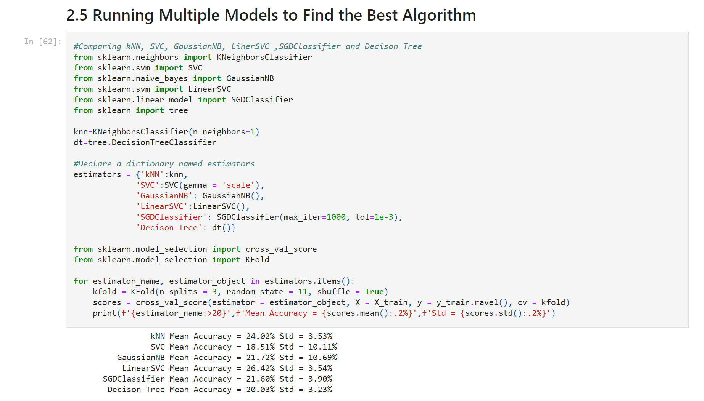
Running Multiple Models to Find the Top 3 Algorithm
K-Fold Cross-Validation is performed on six classification algorithms.
Through calculation, the mean accuracy and standard deviation is obtained for each algorithm.
Top 3 Algorithm for Digits Dataset
SVC, kNN and SGD
Top 3 Algorithm for Letters Dataset
LinearSVC, kNN and SGD

Slide 14
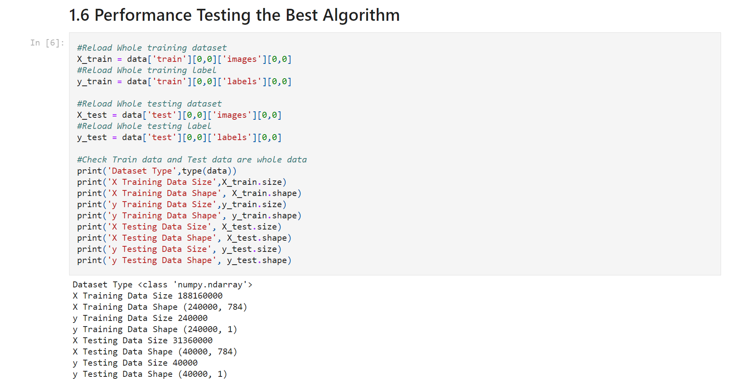
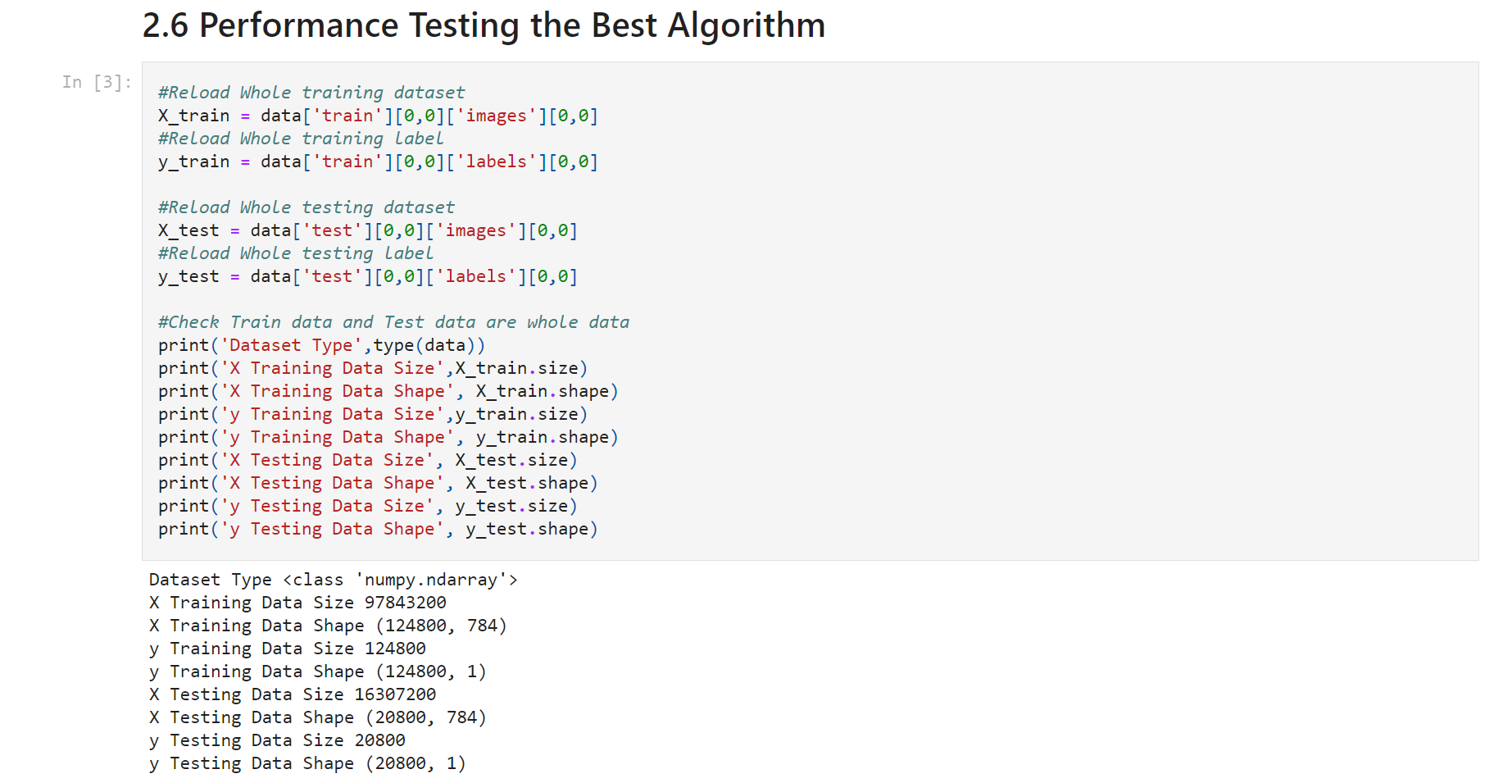
Performance Testing the Top 3 Algorithm Reload All Dataset
Reload all datasets and print data set information for verification.
Digits Dataset
Letters Dataset

Slide 15
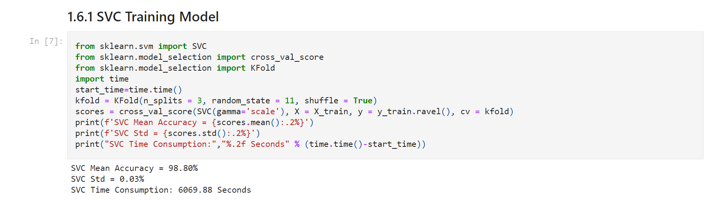
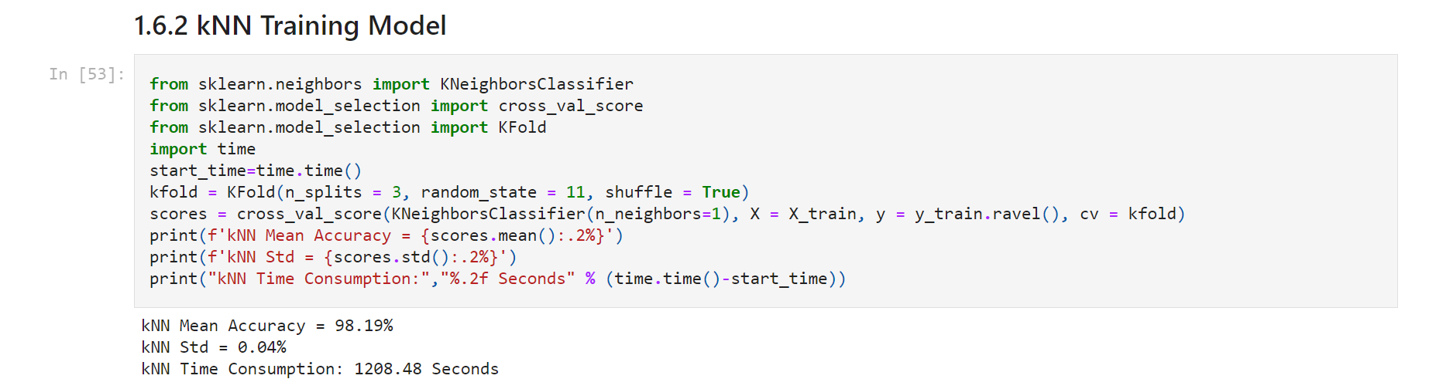
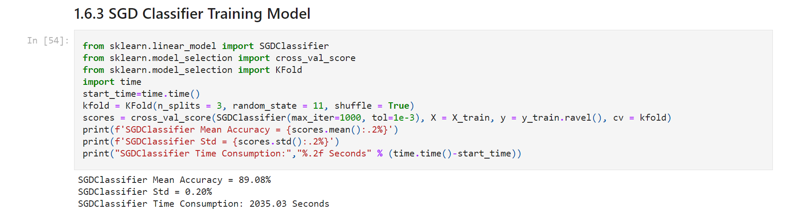
Performance Testing the Top 3 Algorithm For Digits Data

Slide 16
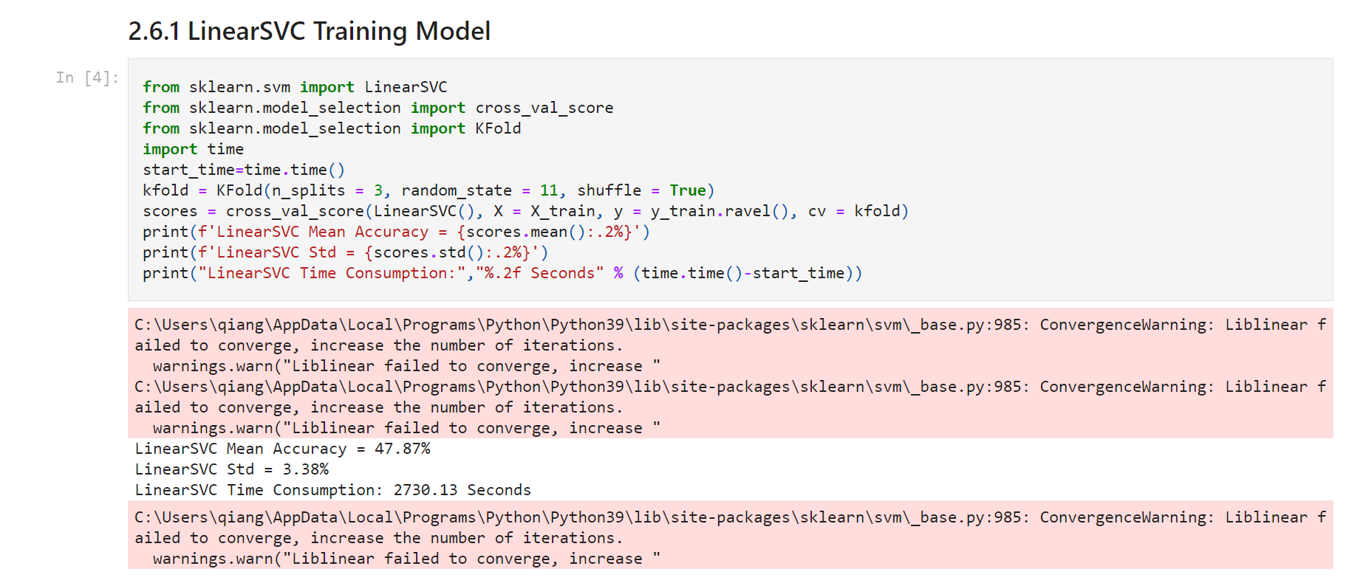
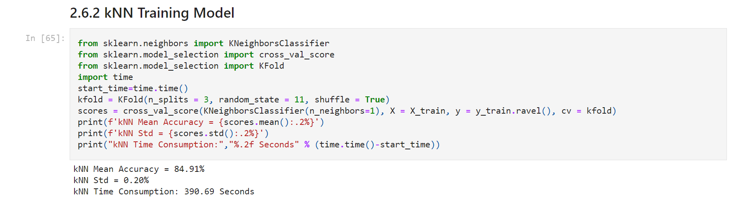
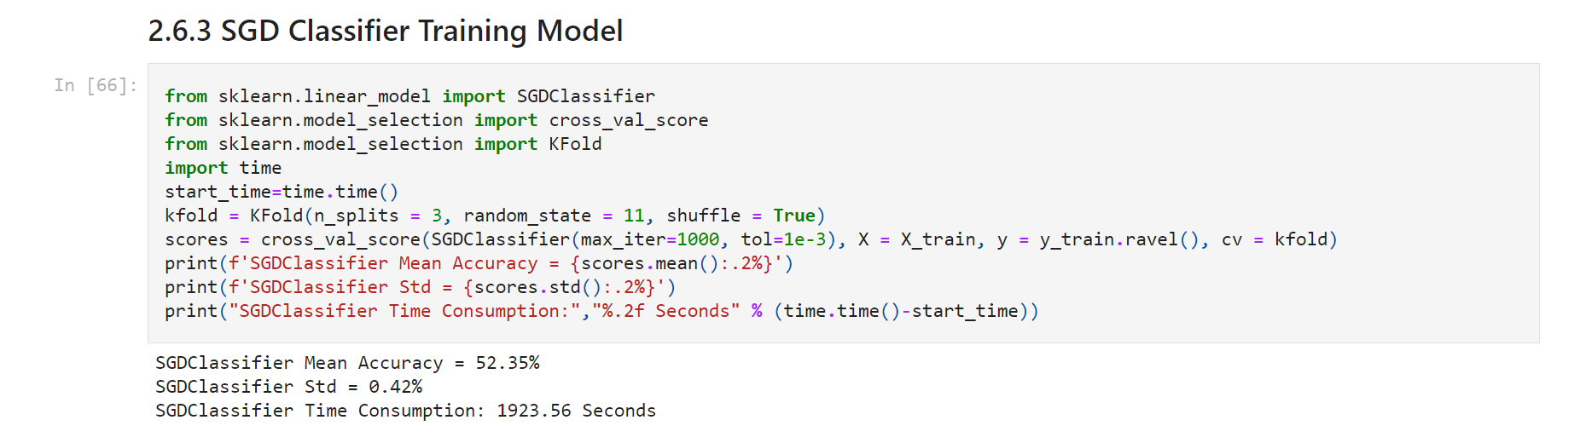
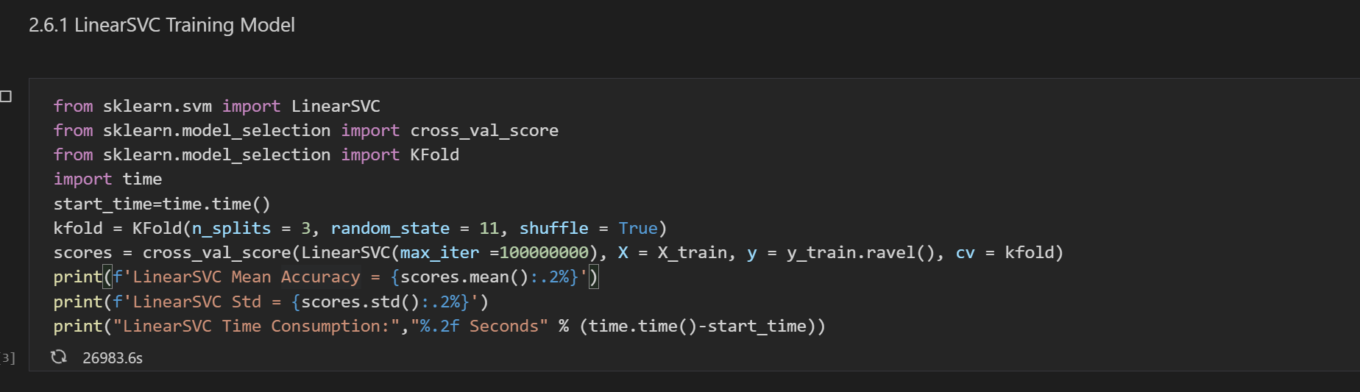
Performance Testing the Top 3 Algorithm For Letters Data
LinearSVC classification algorithm makes mistakes in classifying all data sets, because the default number of iterations is 1000 (Scikit learn) and it is not enough to run.
Modify maximum number to 10000000 performs 26983.6 seconds of operation, but it is left as incomplete.

Slide 17
Conclusion
K-Fold Cross-Validation is used for testing, and tune n splits to get the best test results. K is tuned to get the best test results for kNN classification algorithms.
Dataset | Algorithm | Mean Accuracy | Standard Deviation | Time Consumption
Digits | SVC | 98.8% | 0.03% | 6069.88 Seconds
Digits | kNN | 98.19% | 0.04% | 1208.48 Seconds
Digits | SGD | 89.08% | 0.2% | 2035.03 Seconds
Letters | LinearSVC | N/A | N/A | N/A
Letters | kNN | 84.91% | 0.2% | 390.69 Seconds
Letters | SGD | 52.35% | 0.42% | 1923.56 Seconds
All test results are displayed from the above table. kNN algorithm takes the fastest time in digital dataset, nearly 1 time fast than SGD algorithm and 5 times faster than SVC algorithm, while the mean accuracy is only 0.61% lower than SVC algorithm and 0.1% for standard deviation.
Due to the failure of the linearSVC algorithm test for letters dataset, kNN algorithm is the fastest. It is 5 times faster than SGD algorithm, 32.56% higher than the SGD algorithm for accuracy, and 0.22% lower for standard deviation.
In summary, kNeighborsClassifier Classification algorithm has the advantages of fast calculation, high mean accuracy and low standard deviation.

Slide 18
References
Scikit learn. sklearn.svm.LinearSVC. https://scikit-learn.org/stable/modules/generated/sklearn.svm.LinearSVC.html
The EMNIST Dataset. (2019, March, 28). The EMNIST Dataset. https://www.nist.gov/itl/products-and-services/emnist-dataset

